Slide 1

Lifepath
Brinkburn 2023!
Are you ready for another week of action packed, fun filled learning - because here we come…

Slide 2




Slide 3
Children coming to Lifepath will take part in
4 Workshops covering -
Living
Exploring
Learning
Believing

Slide 4
The
Workshops
Include…

Slide 5
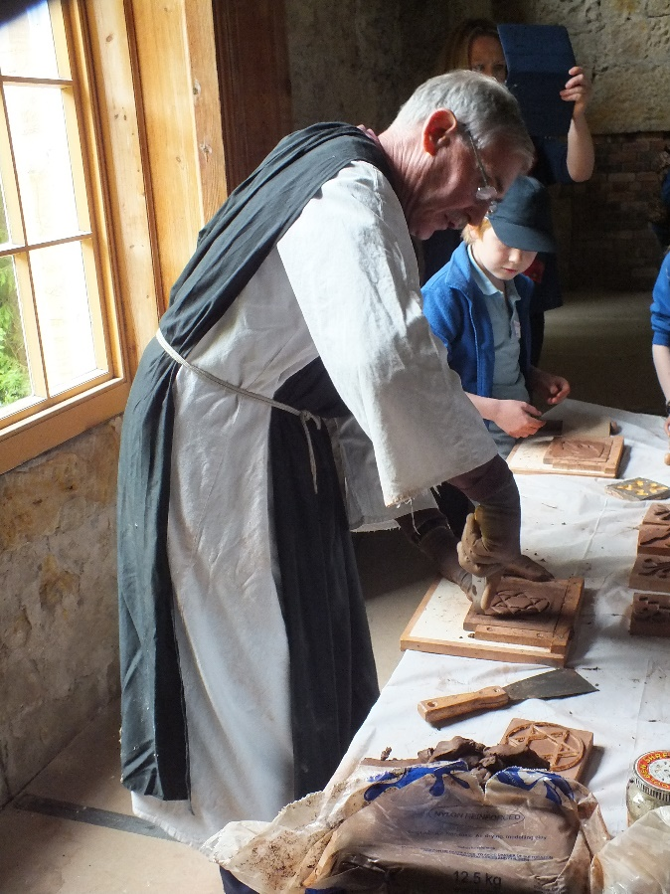
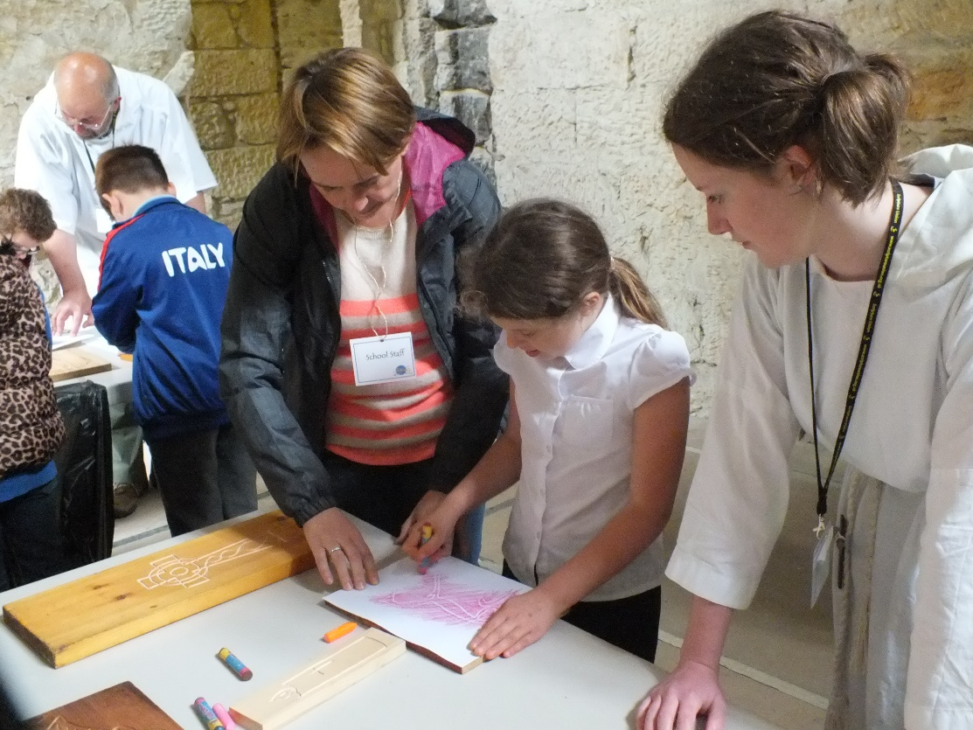
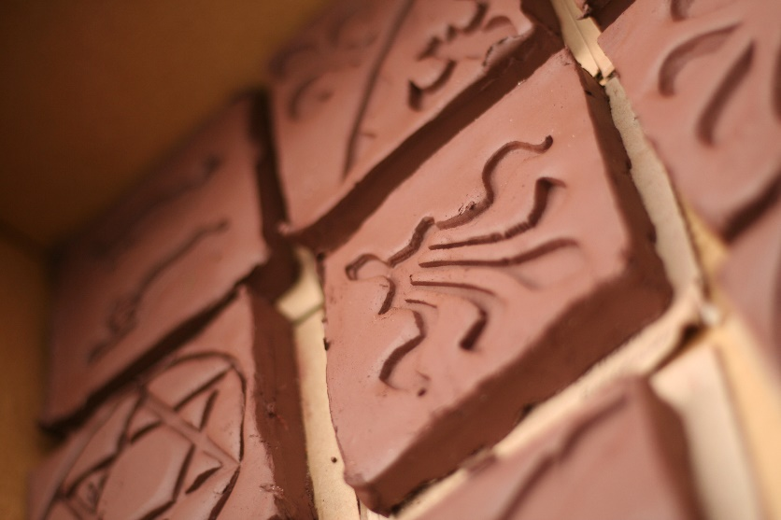
Tile Making and Wood Rubbing

Slide 6
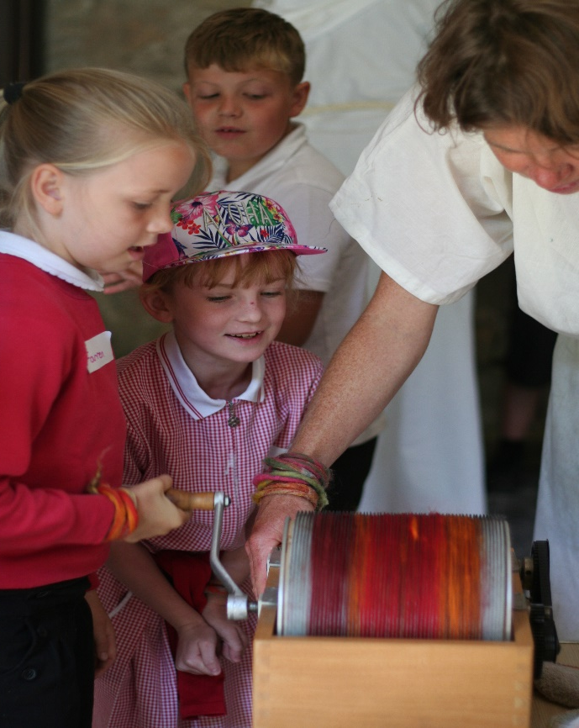
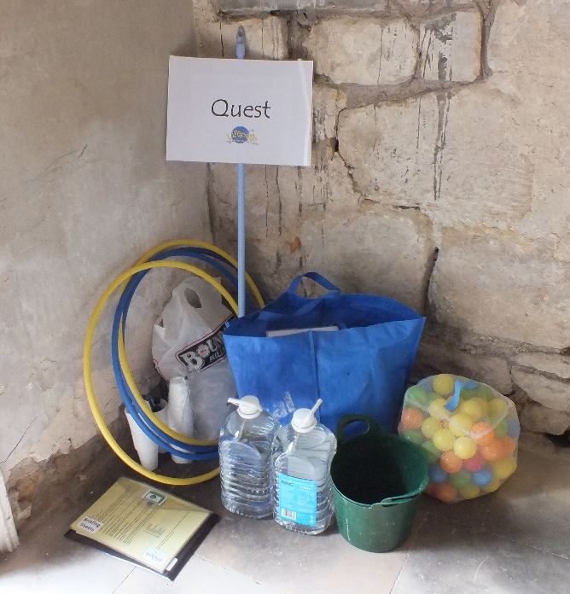
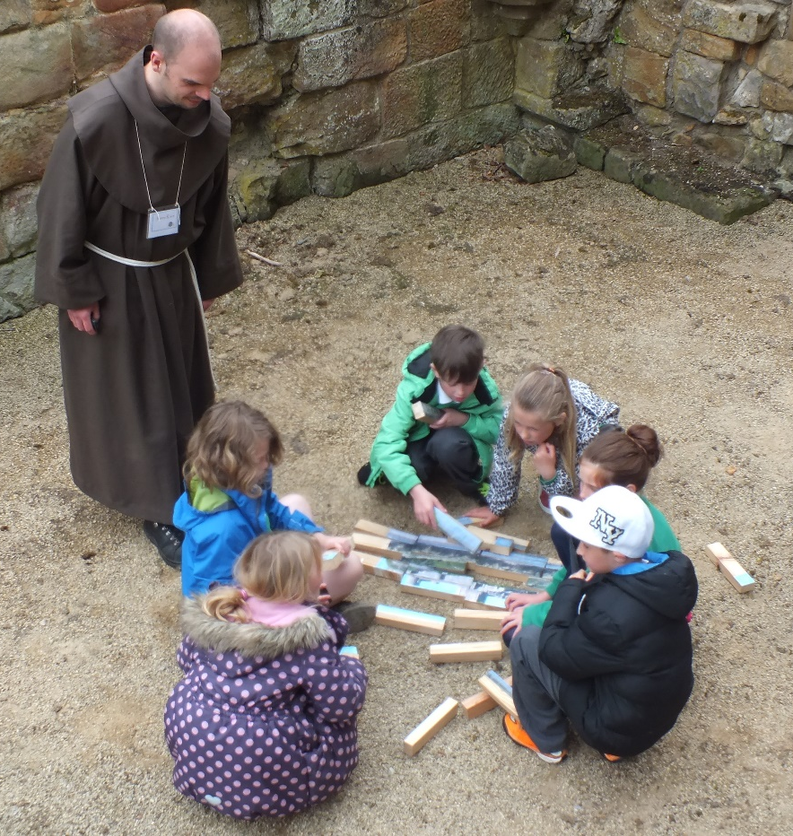
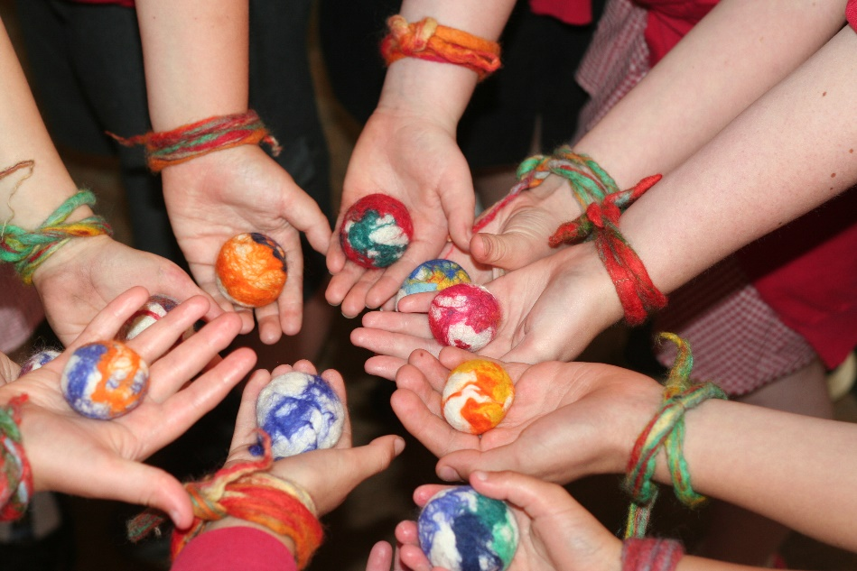
Quest
Felt Making

Slide 7
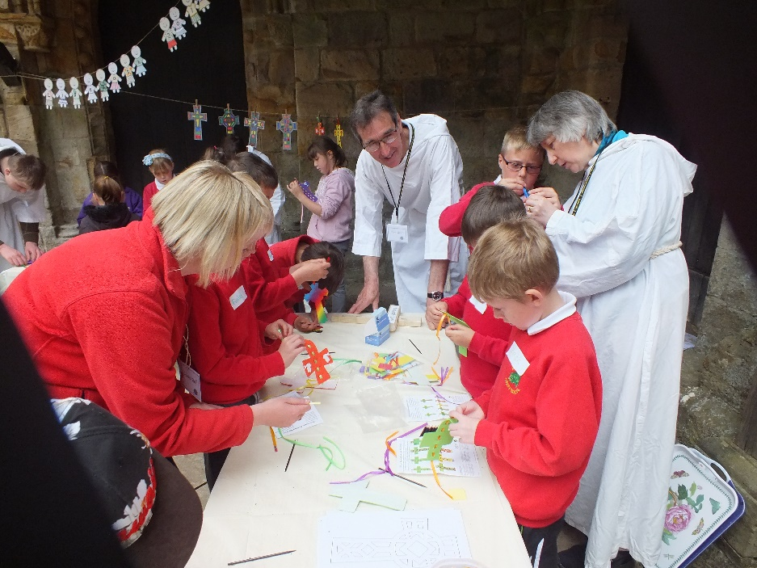
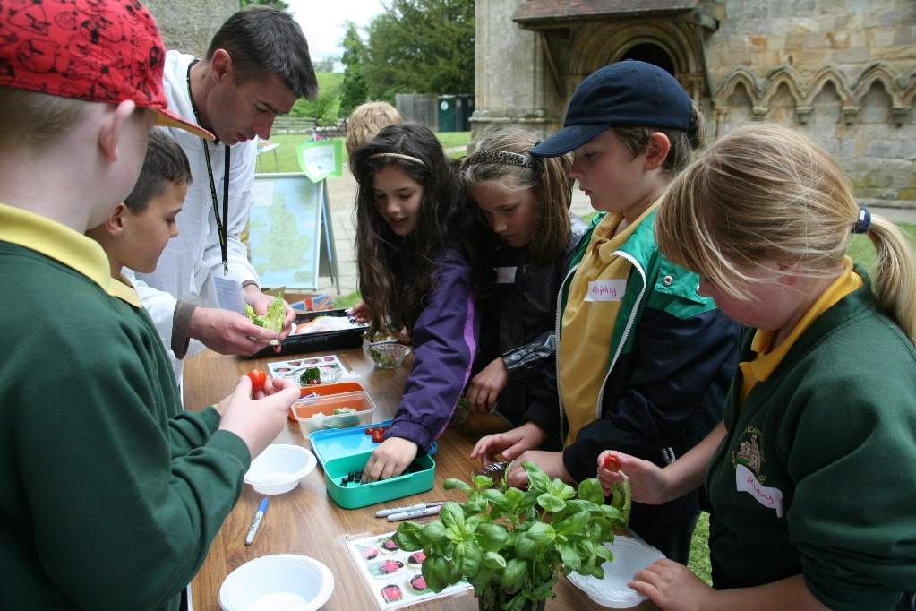
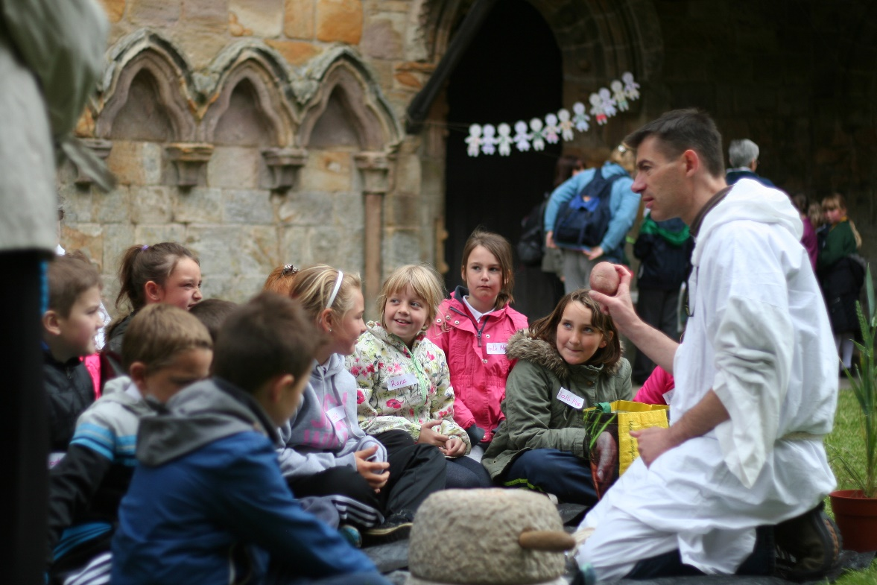
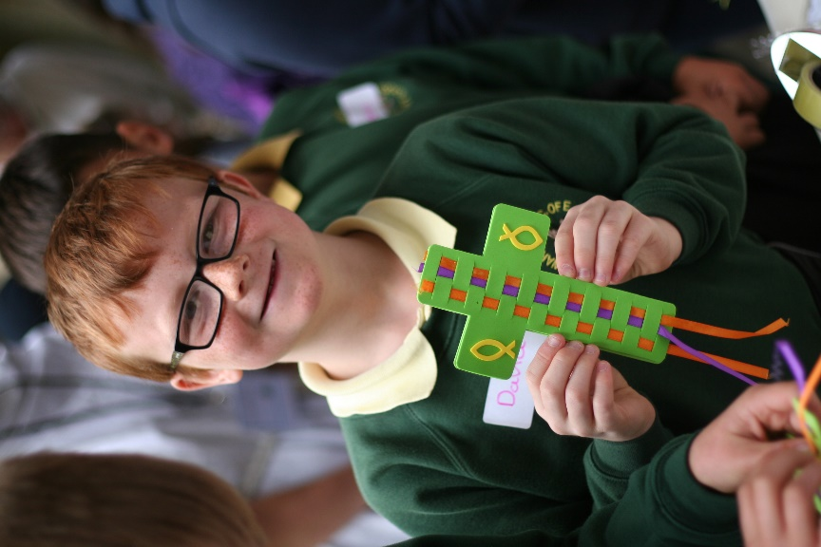
Crafts
Gardening

Slide 8
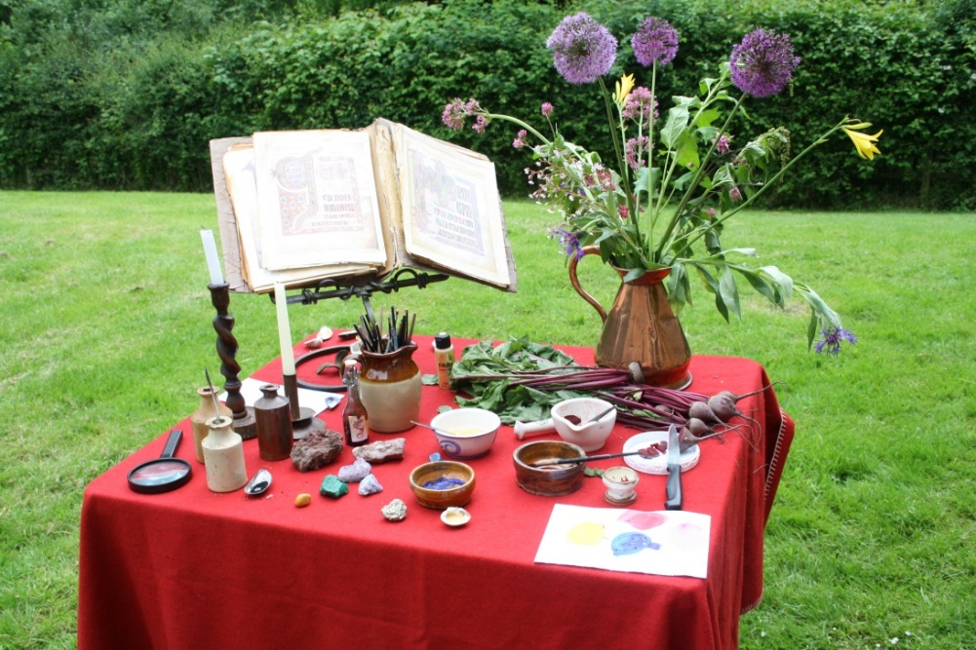
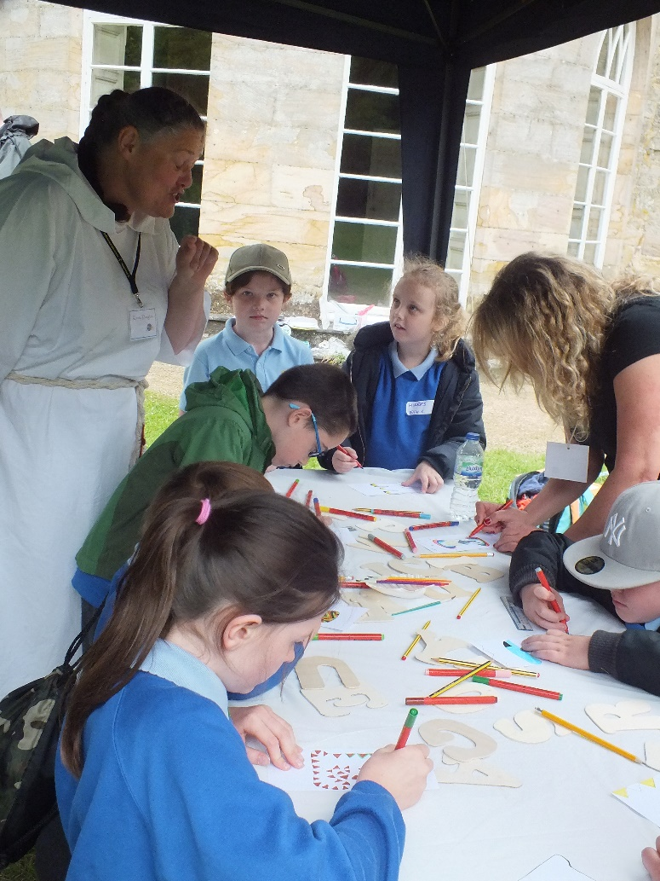
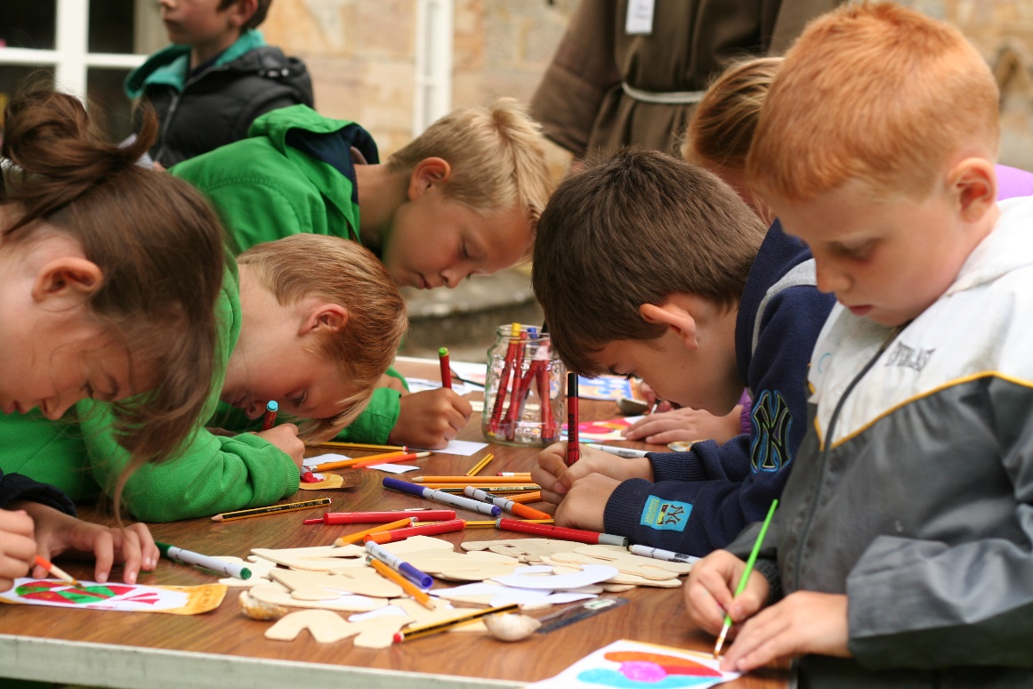
Scriptorium

Slide 9
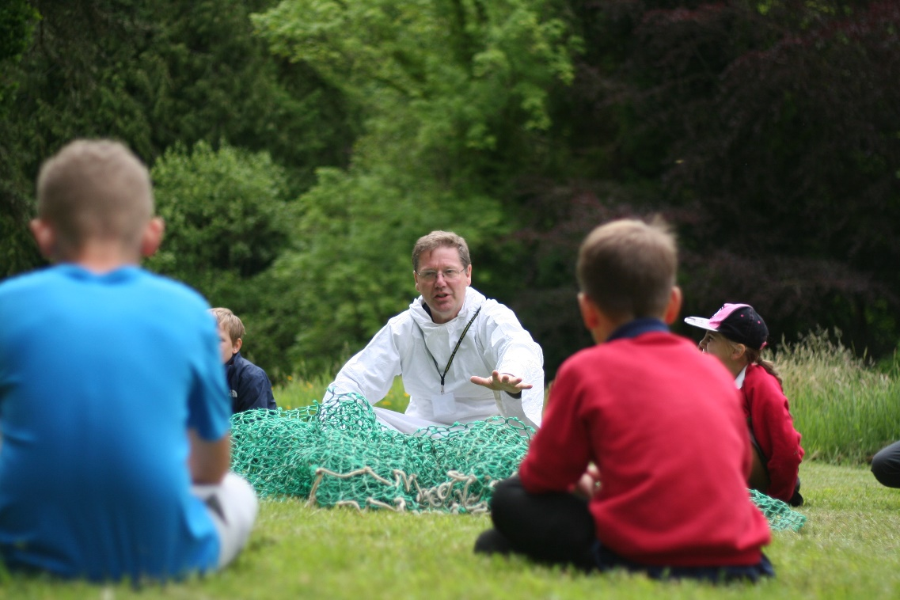
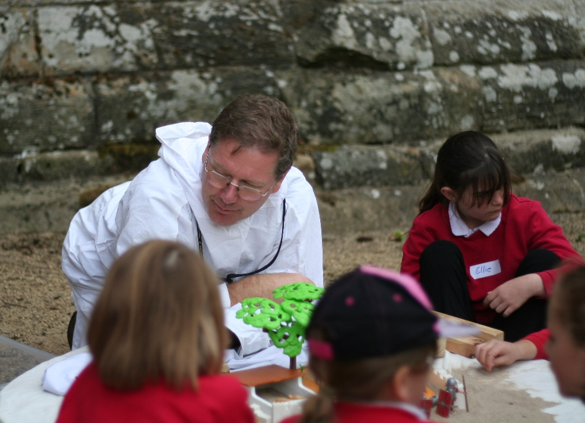
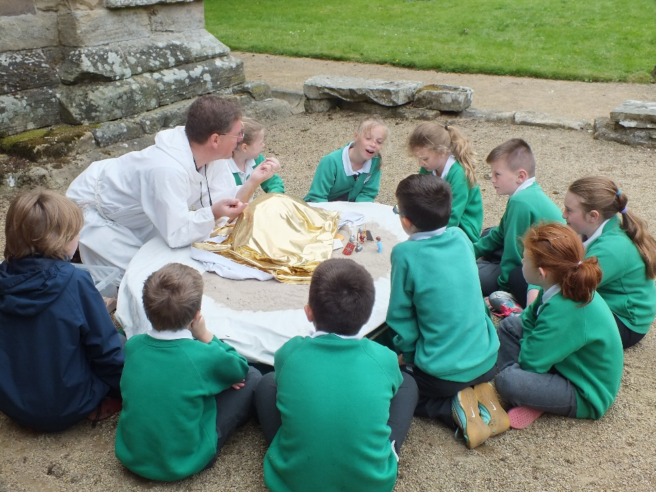
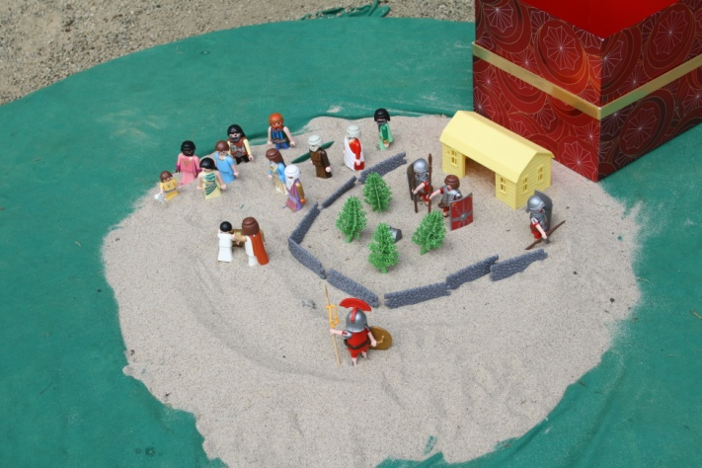
Jesus Journey
(Story telling)

Slide 10
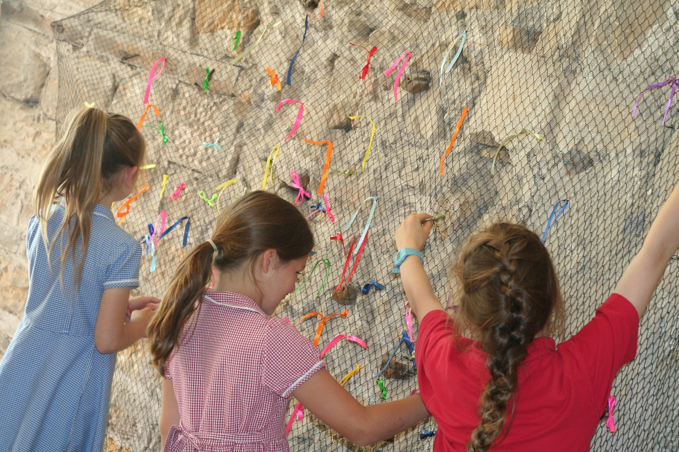
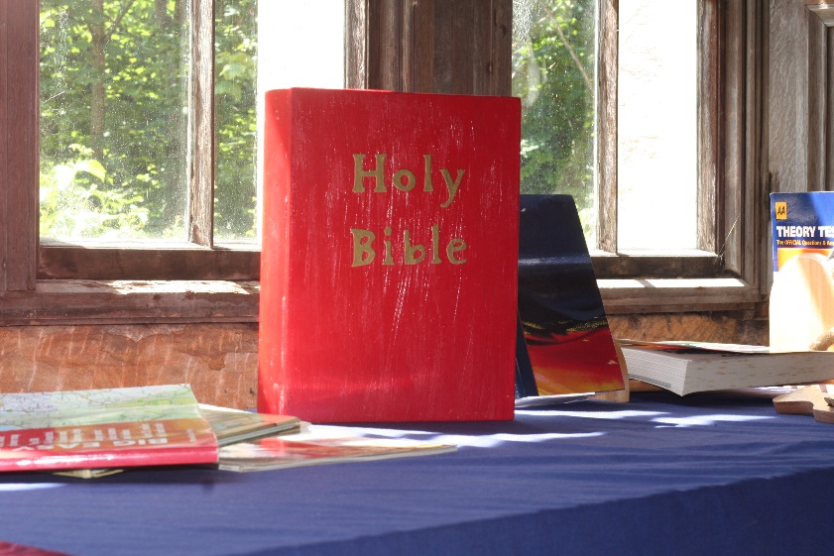
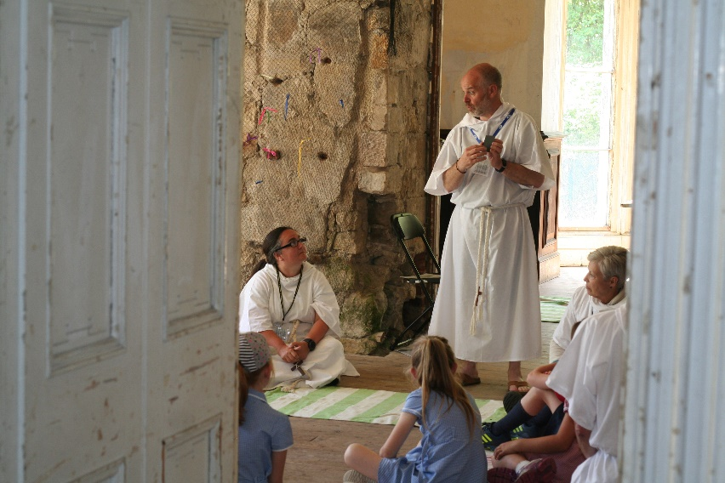
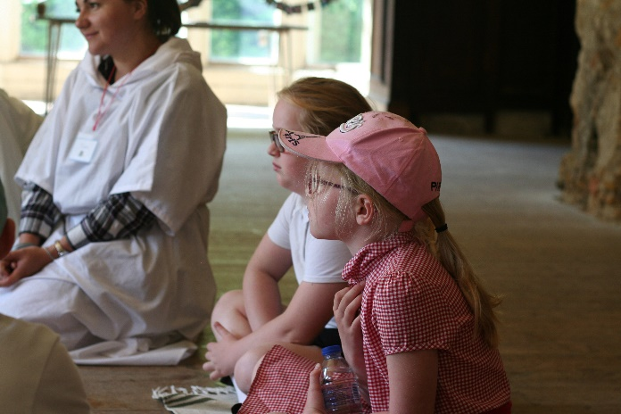
Prayer
Journey
Bible Journey

Slide 11
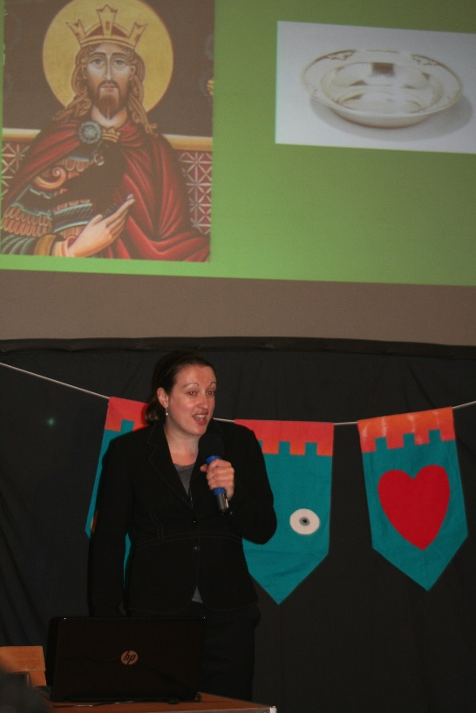
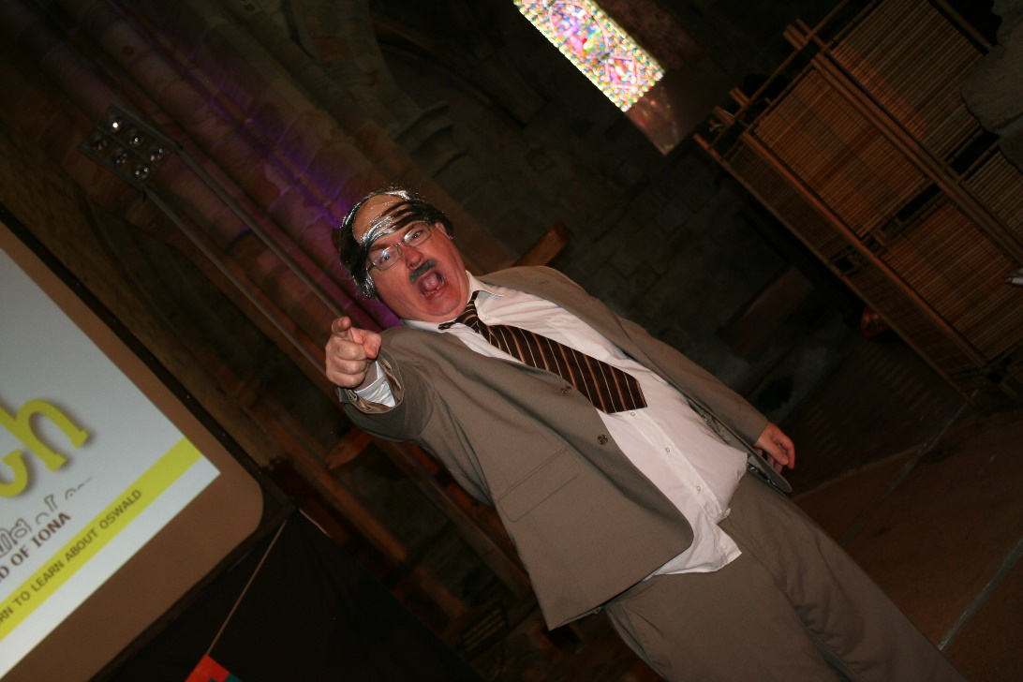
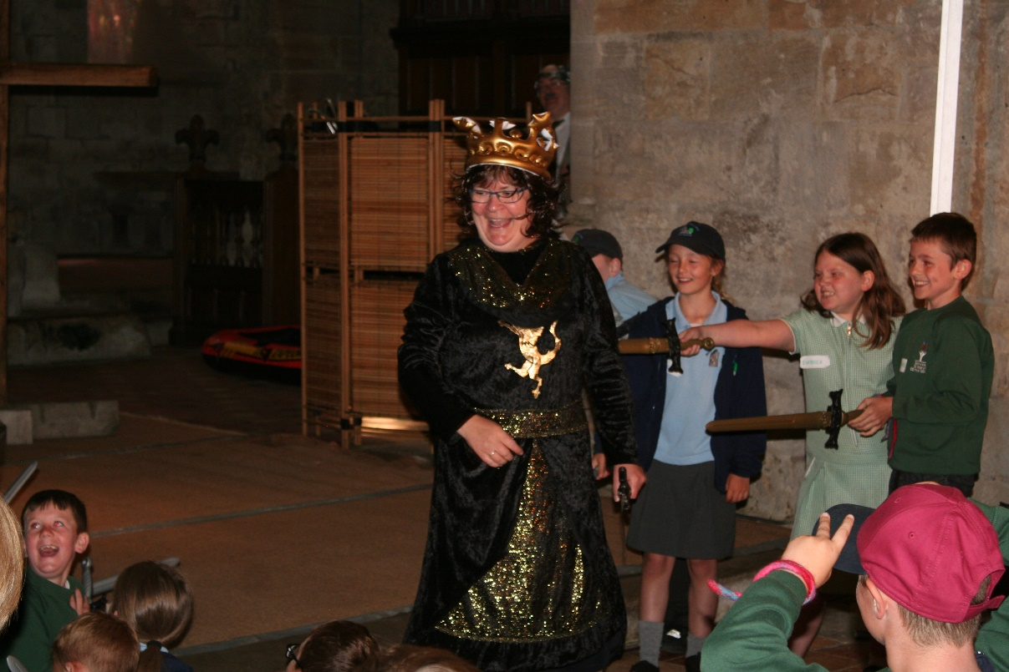
And of course (drum roll please)
our drama

Slide 12
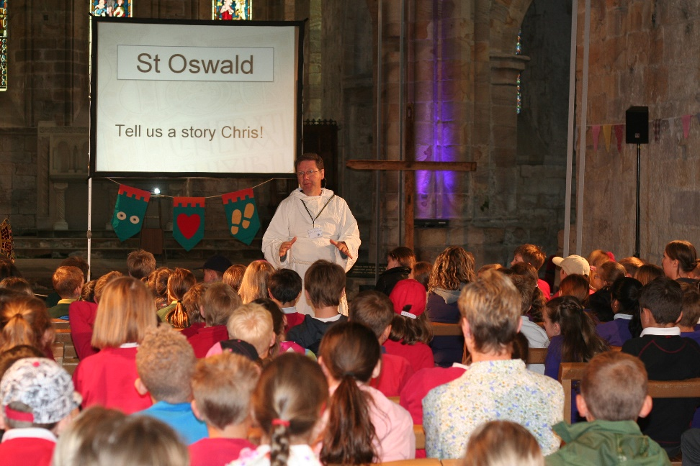
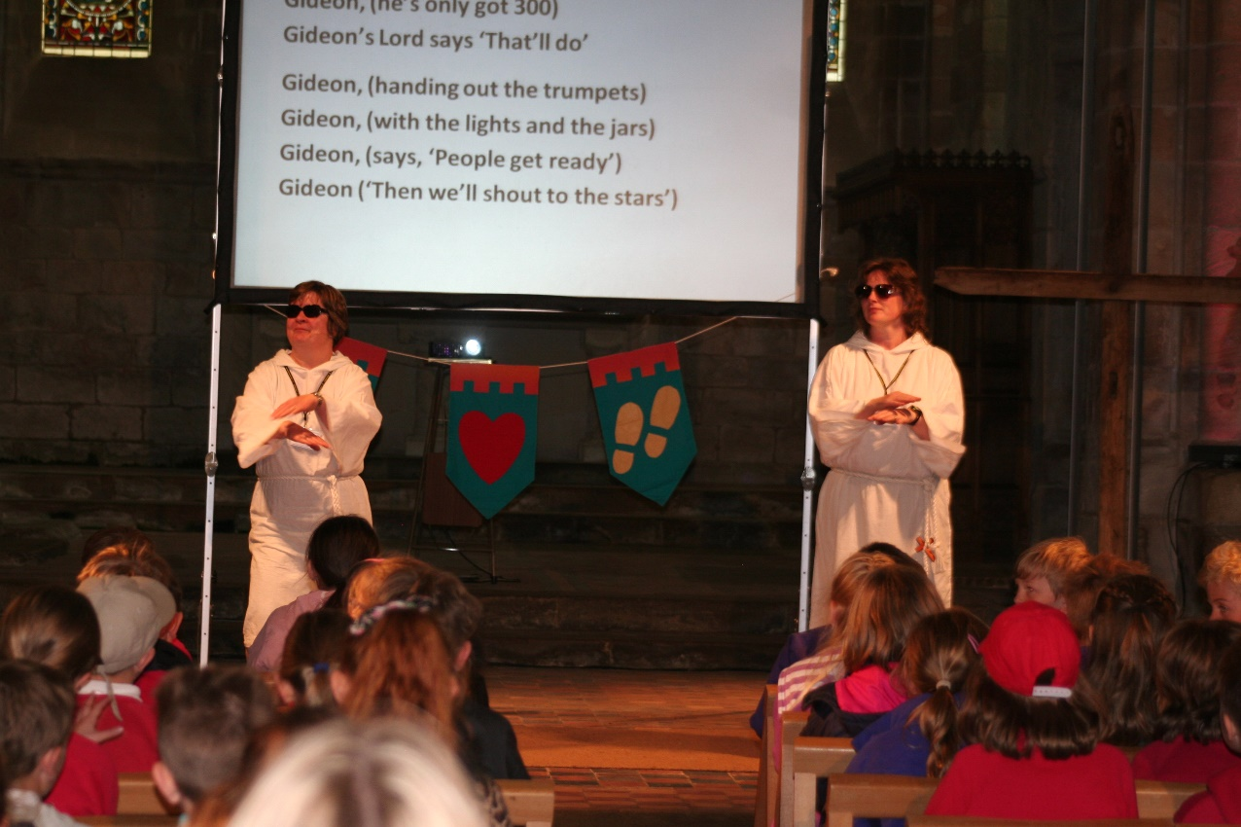
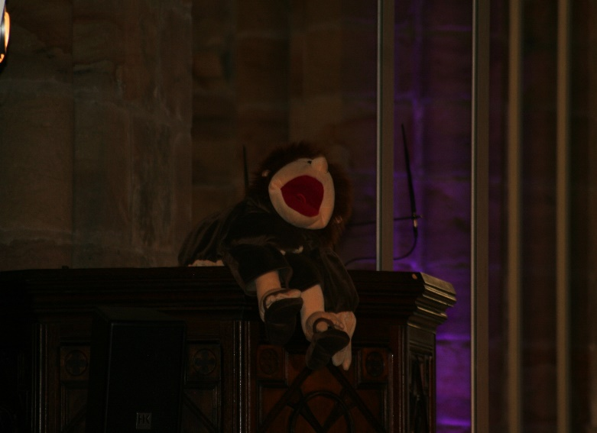
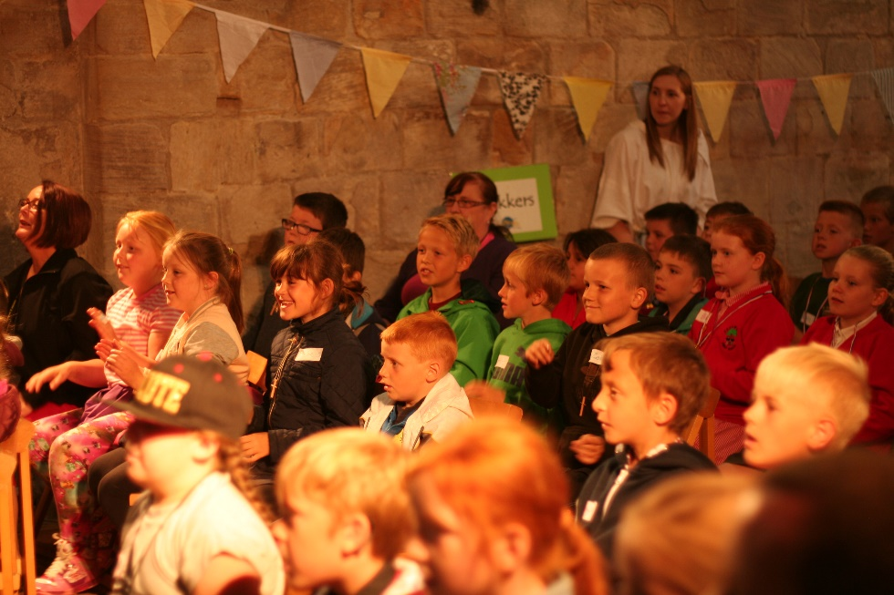
Each day starts and finishes with a time of Collective Worship.

Slide 13
Reviews
“I learnt the Bible can be fun” “When we were there, I was really interested in everything. I am not really a religious person, so this surprised me” (Pupils)
"Very funny, memorable and the key message delivered well" "I loved the day, it was my first time… looking forward to next time" (Teachers)
"It was clear that God was very present in a special way"
"Fabulous as always, lovely to integrate new people into the team" (Volunteers)

Slide 14
Can You Help?
We are looking for volunteers to:
Pray
Be part of the team at Brinkburn Workshop leaders, Pilgrim Guides, Stewards, etc.
Support Lifepath financially

Slide 15
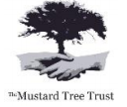


26th – 30th June 2023
If you can help in anyway please speak to your church’s
Lifepath Champion

